Slide 1

Math's 6
Welcome to Calculus

Slide 2
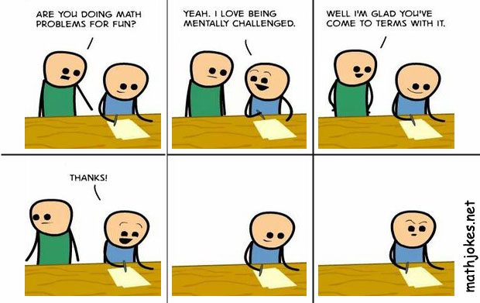
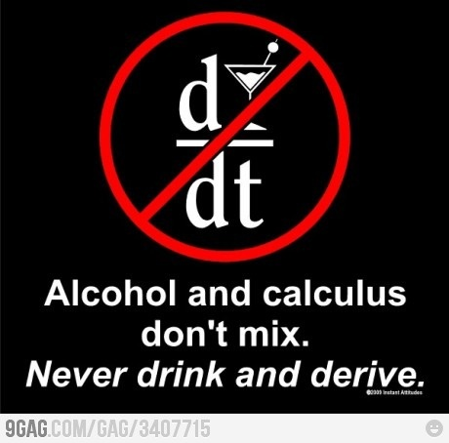
Calculus… I really am sorry

Slide 3
Differentiation
Calculus, this is where things get interesting and complicated.
Calculus is the study of change. Applying mathematics to change.

Slide 4
Differentiation
Differentiation is one of the two branches of calculus.
It focuses on studying the rate of change of a function.

Slide 5
Differentiation
It focuses on studying the rate of change of a function.
If we look at a linear function we realise we have already learnt about rate of change.

Slide 6
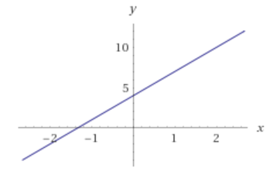
Differentiation
If we look at a linear function we realise we have already learnt about rate of change.
The equation y = 3x + 4 is linear.
The gradient of the line is 3

Slide 7
Differentiation
The equation y = 3x + 4 is linear.
The gradient of the line is 3
What this means is that for every
1 movement in the x axis it gains
3 on the y axis.

Slide 8
Differentiation
The equation y = 3x + 4 is linear.
That means the rate of change is
3 but it does not change
throughout the function.

Slide 9
Differentiation
The equation y = 3x + 4 is linear.
That means the rate of change is
3 but it does not change
throughout the function.
What happens if our line is a
curve?

Slide 10
Differentiation
So if we have a function that is not a straight line.

Slide 11
Differentiation
Obviously the difference from one point to the next is not the same at the different points.

Slide 12
Differentiation
If we look at a single specific point on the curve.

Slide 13
Differentiation
If we want to calculate the rate of change or gradient for this point what can we do?

Slide 14
Differentiation
We can take a linear approximation of the gradient at that specific point.

Slide 15
Differentiation
So we need to find the rate of change at this point by approximating it to a linear equation.

Slide 16
Differentiation
How?

Slide 17
Differentiation
With the magic of differentiation!*
*Maths is like magic, one thing can turn into another and you have no idea how it works

Slide 18
Differentiation
We call this the derivative.

Slide 19
Differentiation
But how do we get a derivative?

Slide 20
Differentiation
Well we are trying to find the gradient of a line that is at a tangent to a specific point.
How do we find gradient?

Slide 21
Differentiation
Well we are trying to find the gradient of a line that is at a tangent to a specific point.
How do we find gradient?
Our straight line equation is y=mx+c

Slide 22
Differentiation
Well we are trying to find the gradient of a line that is at a tangent to a specific point.
How do we find gradient?
Our straight line equation is y=mx+c
m = y/x +c

Slide 23
Differentiation
m = y/x +c
Lets ignore the constant

Slide 24
Differentiation
m = y/x
Now this formula is simplified a bit.
When we go from one point to another we are looking at the change in the y axis and the change in the x axis
In linear equations there is no variation so it is simplified.

Slide 25

Differentiation
So our formula should be
$m= \frac{Change in y}{change in x}$

Slide 26

Differentiation
So our formula should be
$m= \frac{Change in y}{change in x}$ or
$m= \frac{∆y}{∆x}$

Slide 27

Differentiation
But this is often just written
$m= \frac{dy}{dx}$

Slide 28

Differentiation
But this is often just written
$m= \frac{dy}{dx}$ or sometimes just f’(x) or lots of other notation.

Slide 29

Differentiation
$\frac{dy}{dx}$
This can be applied to single points on a function to find the gradient of the tangent line.

Slide 30
Differentiation
$\frac{dy}{dx}$
This can be applied to single points on a function to find the gradient of the tangent line.

Slide 31
Differentiation
So how do we get the derivative of a function?
Well there are lots of rules depending on the what is inside the function you are differentiating.

Slide 32
Differentiation
The simplest rule of differentiation is the derivatives of constant
Think of the equation y = 5

Slide 33
Differentiation
The simplest rule of differentiation is the derivatives of constant
Think of the equation y = 5
This means that for every value of x y = 5
Note y = 5 can be thought of as y =0x + 5

Slide 34
Differentiation
y =0x + 5
This flat line at 5 has no gradient because there is no change from point to point.
So when we differentiate a constant we get 0 because there is not change!

Slide 35
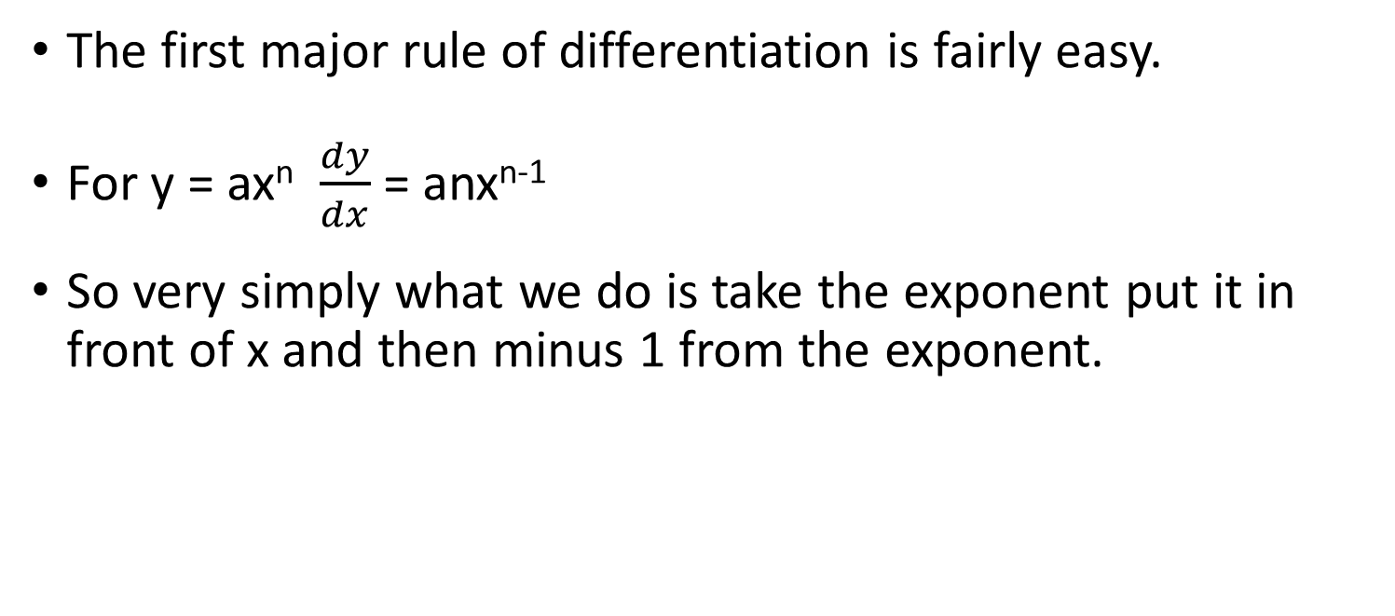
Differentiation
The first major rule of differentiation is fairly easy.
For y = ax^{n} $\frac{dy}{dx}$ = anx^{n-1}
So very simply what we do is take the exponent put it in front of x and then minus 1 from the exponent.

Slide 36

Differentiation
For y = ax^{n} $\frac{dy}{dx}$ = anx^{n-1}
So lets look at y = x²

Slide 37

Differentiation
For y = ax^{n} $\frac{dy}{dx}$ = anx^{n-1}
So lets look at y = x²
First take the exponent and put it in front.

Slide 38

Differentiation
For y = ax^{n} $\frac{dy}{dx}$ = anx^{n-1}
So lets look at y = x²
First take the exponent and put it in front.
$\frac{dy}{dx}$ = 2x²

Slide 39

Differentiation
For y = ax^{n} $\frac{dy}{dx}$ = anx^{n-1}
So lets look at y = x²
Then subtract 1 from the exponent.
$\frac{dy}{dx}$ = 2x² ⁻ ¹

Slide 40

Differentiation
For y = ax^{n} $\frac{dy}{dx}$ = anx^{n-1}
So lets look at y = x²
Then subtract 1 from the exponent.
$\frac{dy}{dx}$ = 2x¹

Slide 41

Differentiation
For y = ax^{n} $\frac{dy}{dx}$ = anx^{n-1}
So lets look at y = x²
Anything to the power 1 is just itself.
$\frac{dy}{dx}$ = 2x

Slide 42

Differentiation
For y = ax^{n} $\frac{dy}{dx}$ = anx^{n-1}
So lets look at y = x²
Done
$\frac{dy}{dx}$ = 2x

Slide 43

Differentiation
For y = ax^{n} $\frac{dy}{dx}$ = anx^{n-1}
How about when there is a coefficient on the x, some constant it is being multiplied by:

Slide 44
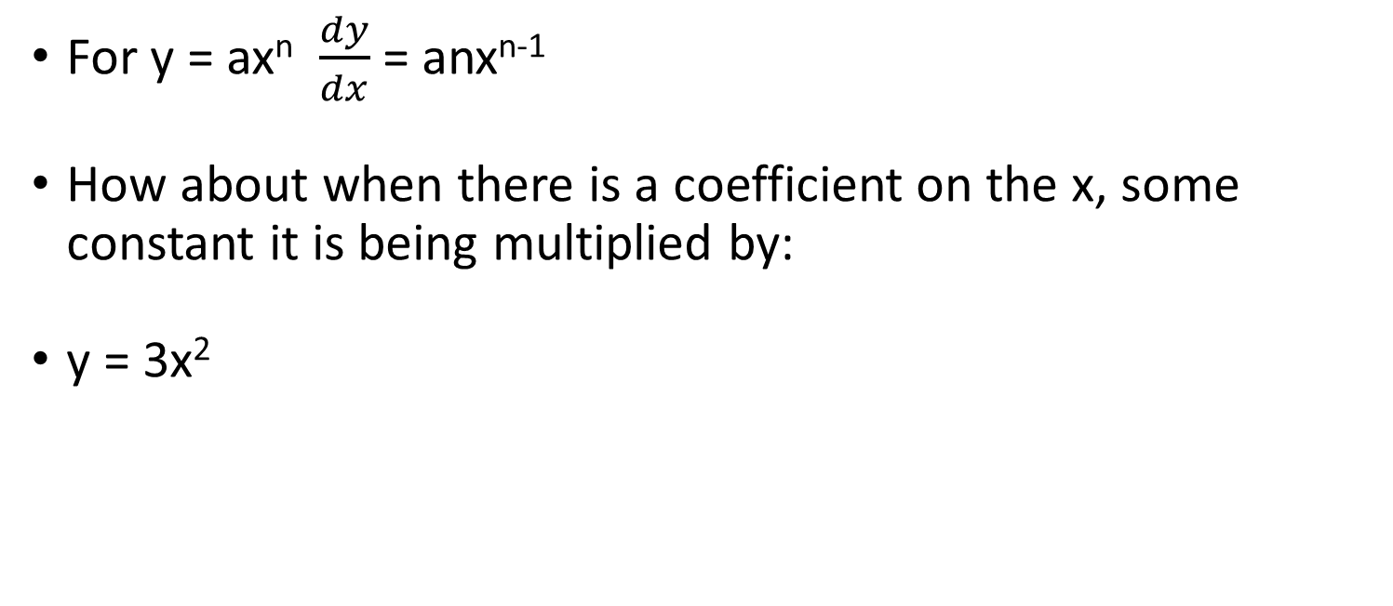
Differentiation
For y = ax^{n} $\frac{dy}{dx}$ = anx^{n-1}
How about when there is a coefficient on the x, some constant it is being multiplied by:
y = 3x²

Slide 45
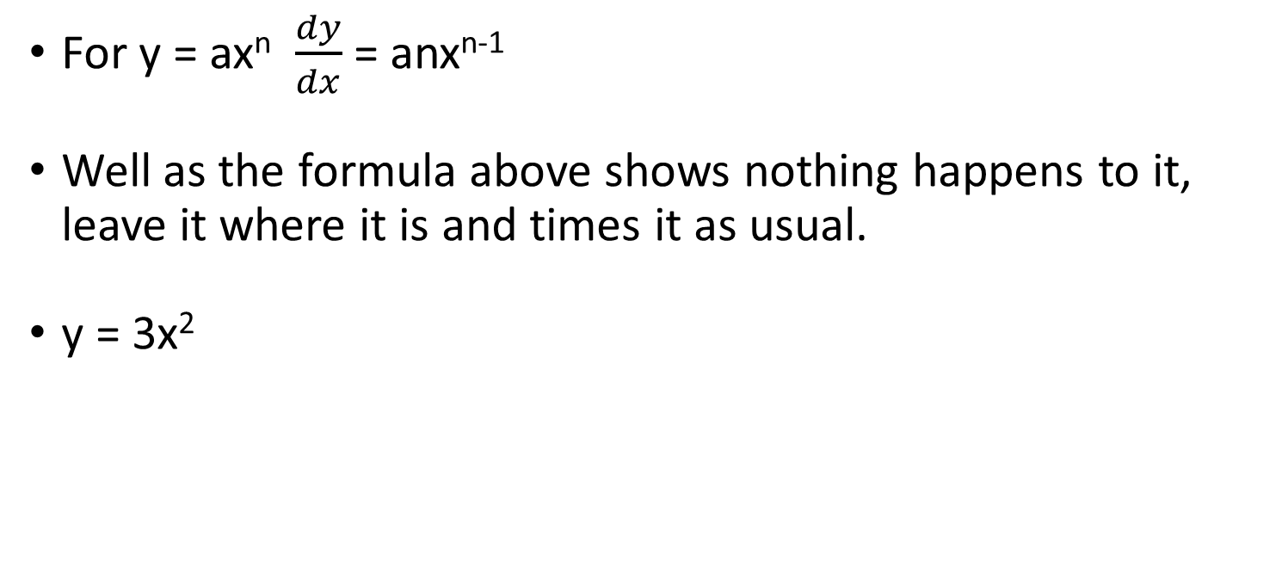
Differentiation
For y = ax^{n} $\frac{dy}{dx}$ = anx^{n-1}
Well as the formula above shows nothing happens to it, leave it where it is and times it as usual.
y = 3x²

Slide 46
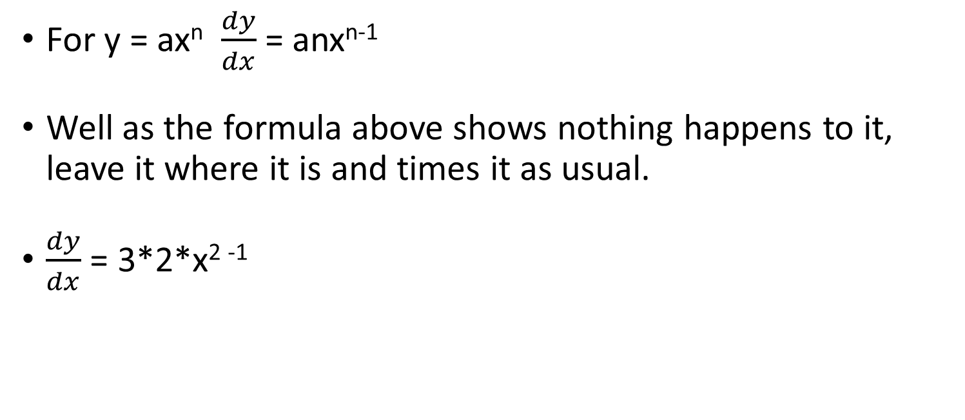
Differentiation
For y = ax^{n} $\frac{dy}{dx}$ = anx^{n-1}
Well as the formula above shows nothing happens to it, leave it where it is and times it as usual.
$\frac{dy}{dx}$ = 3*2*x² ⁻¹

Slide 47
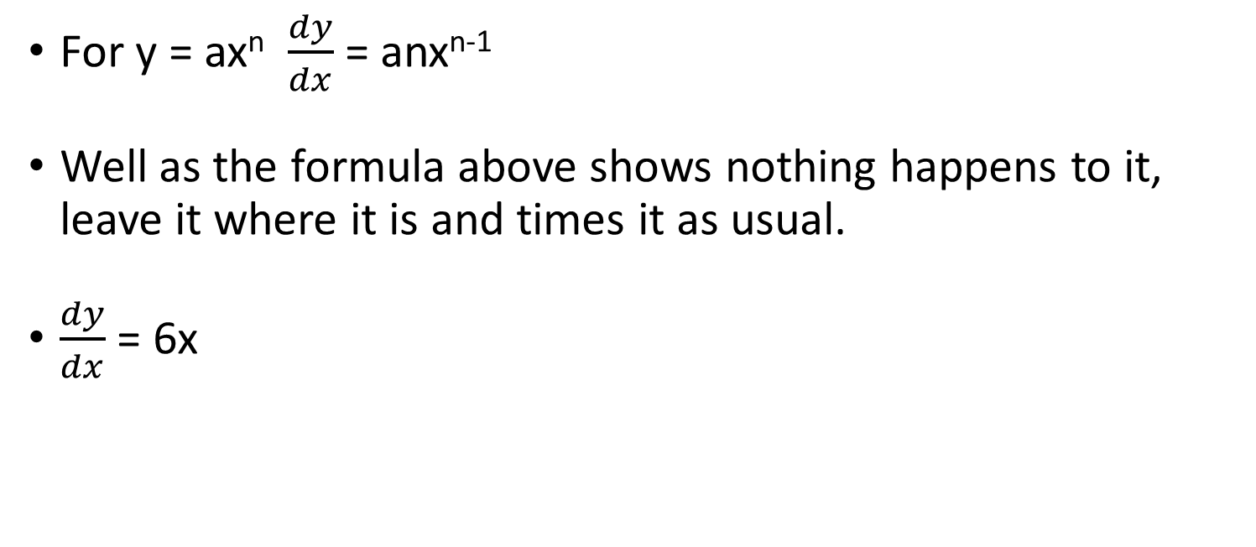
Differentiation
For y = ax^{n} $\frac{dy}{dx}$ = anx^{n-1}
Well as the formula above shows nothing happens to it, leave it where it is and times it as usual.
$\frac{dy}{dx}$ = 6x

Slide 48
Differentiation
What if we want the derivative of a formula with multiple x terms added or subtracted:
y = x² + 3x - 4

Slide 49
Differentiation
Well we just ignore the signs and derive each term separately and then simplify.
y = x² + 3x - 4

Slide 50
Differentiation
First get rid of the constant as we know that it derives to 0
y = x² + 3x - 4

Slide 51

Differentiation
First get rid of the constant as we know that it derives to 0
$\frac{dy}{dx}$ = x² + 3x

Slide 52

Differentiation
Now apply our power rule
$\frac{dy}{dx}$ = x² + 3x

Slide 53

Differentiation
Now apply our power rule
$\frac{dy}{dx}$ = 2 * x²⁻¹ + 1 *3 *x¹⁻¹

Slide 54

Differentiation
Anything to the power of 0 = 1.
$\frac{dy}{dx}$ = 2x + 1 *3 *x⁰

Slide 55

Differentiation
Anything to the power of 0 = 1.
$\frac{dy}{dx}$ = 2x + 1 *3 *1

Slide 56

Differentiation
Anything to the power of 0 = 1.
$\frac{dy}{dx}$ = 2x + 3

Slide 57

Differentiation
And there we have it, this looks like a linear equation but remember all we’ve worked out is the gradient.
$\frac{dy}{dx}$ = 2x + 3

Slide 58
Differentiation
As we’ve learnt in the past we can multiply two functions together, and as we just learnt we can derive functions.
With this we follow a more complicated rule:
If we have a combined function y which is a combination of functions f and g y =fg

Slide 59
Differentiation
As we’ve learnt in the past we can multiply two functions together, and as we just learnt we can derive functions.
With this we follow a more complicated rule:
If we have a combined function y which is a combination of functions f and g y =fg

Slide 60

Differentiation
If we have a combined function y which is a combination of functions f and g y =fg
$\frac{dy}{dx}$ = f $\frac{dg}{dx}$ + g$\frac{df}{dx}$

Slide 61
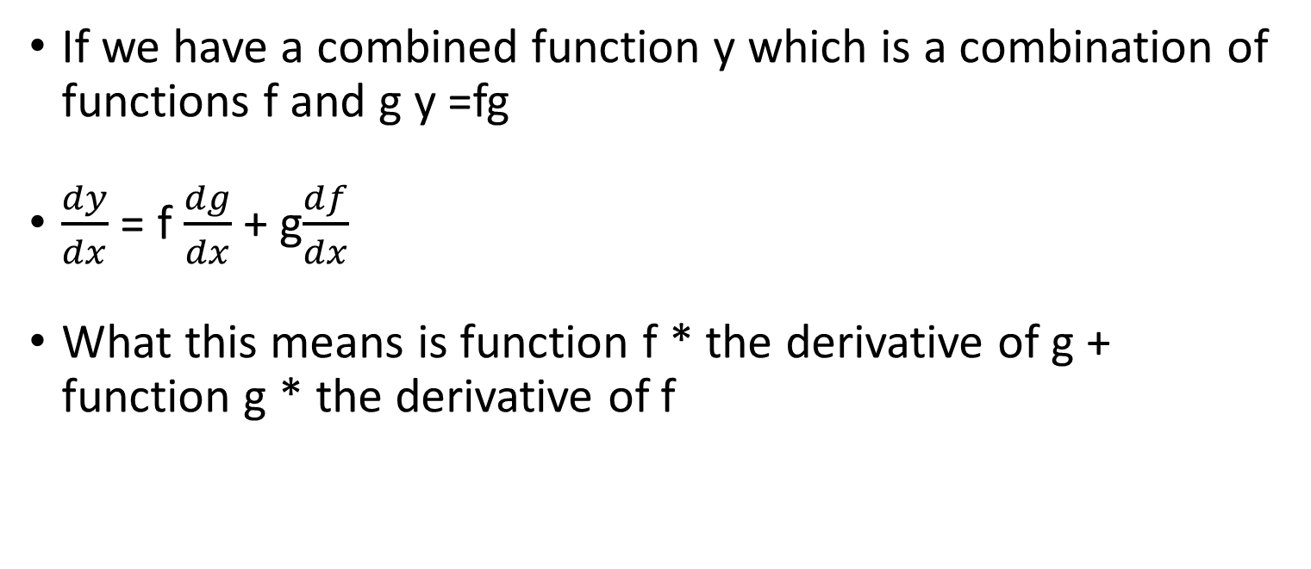
Differentiation
If we have a combined function y which is a combination of functions f and g y =fg
$\frac{dy}{dx}$ = f $\frac{dg}{dx}$ + g$\frac{df}{dx}$
What this means is function f * the derivative of g + function g * the derivative of f

Slide 62

Differentiation
$\frac{dy}{dx}$ = f $\frac{dg}{dx}$ + g$\frac{df}{dx}$
If we have function y = fg where f = 2x² and g = 3x -4
$\frac{dy}{dx}$ = 2x² $\frac{dg}{dx}$ + (3x – 4)$\frac{df}{dx}$

Slide 63

Differentiation
$\frac{dy}{dx}$ = f $\frac{dg}{dx}$ + g$\frac{df}{dx}$
If we have function y = fg where f = 2x² and g = 3x -4
$\frac{dy}{dx}$ = 2x² * 3 + (3x – 4) * 4x

Slide 64
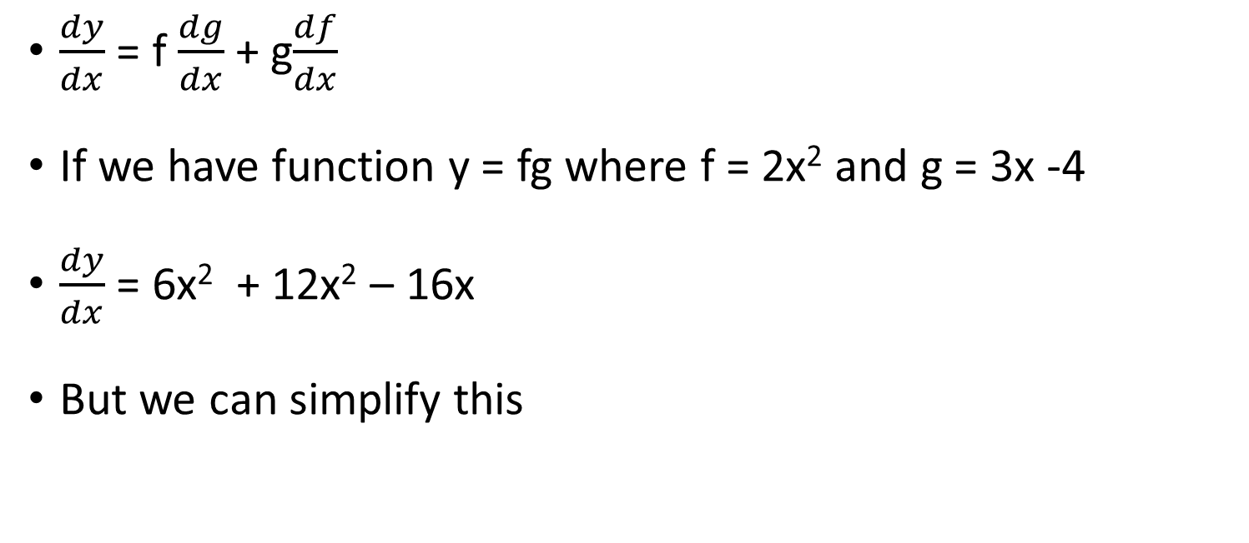
Differentiation
$\frac{dy}{dx}$ = f $\frac{dg}{dx}$ + g$\frac{df}{dx}$
If we have function y = fg where f = 2x² and g = 3x -4
$\frac{dy}{dx}$ = 6x² + 12x² – 16x
But we can simplify this

Slide 65
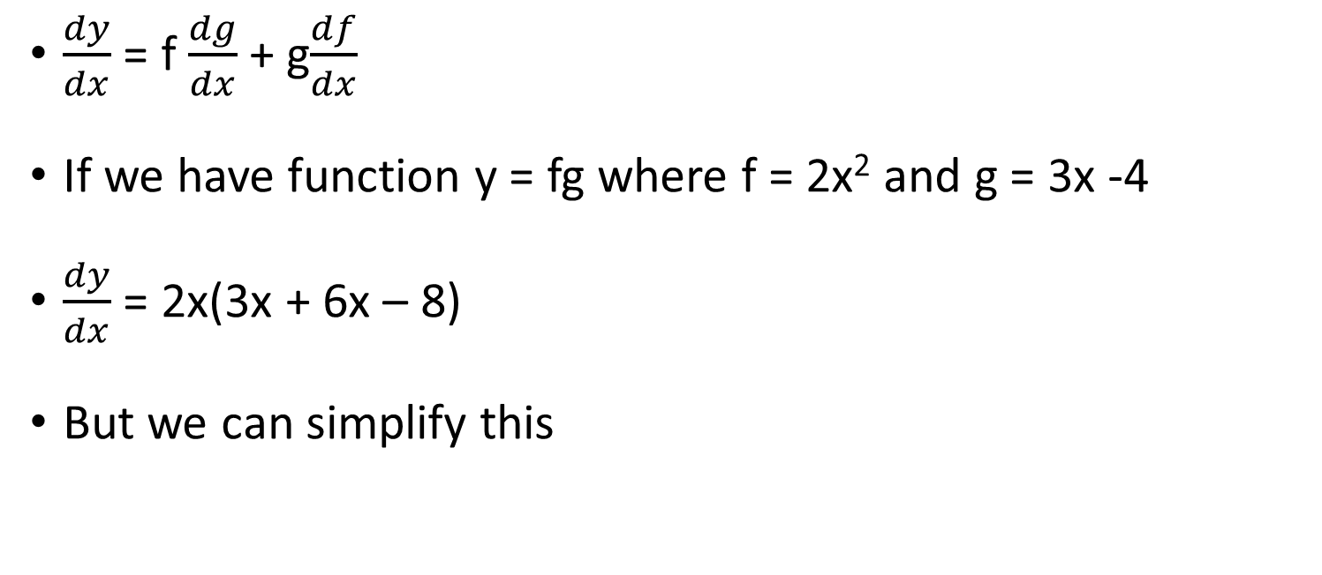
Differentiation
$\frac{dy}{dx}$ = f $\frac{dg}{dx}$ + g$\frac{df}{dx}$
If we have function y = fg where f = 2x² and g = 3x -4
$\frac{dy}{dx}$ = 2x(3x + 6x – 8)
But we can simplify this

Slide 66

Differentiation
$\frac{dy}{dx}$ = f $\frac{dg}{dx}$ + g$\frac{df}{dx}$
If we have function y = fg where f = 2x² and g = 3x -4
$\frac{dy}{dx}$ = 2x(9x – 8)

Slide 67

Differentiation
Now what if we want to divide two functions:
y = $\frac{2x−2}{x^{3}}$

Slide 68

Differentiation
Now what if we want to divide two functions:
y = $\frac{2x−2}{x^{3}}$
The quotient rule for dividing functions is:

Slide 69
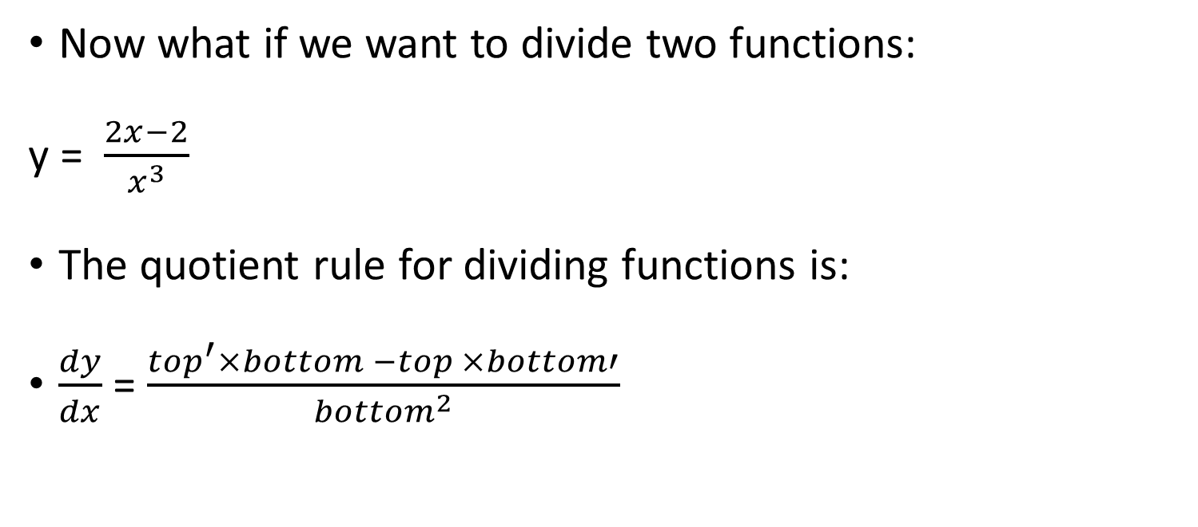
Differentiation
Now what if we want to divide two functions:
y = $\frac{2x−2}{x^{3}}$
The quotient rule for dividing functions is:
$\frac{dy}{dx}$ = $\frac{top^{′}×bottom −top ×bottom′}{{bottom}^{2}}$

Slide 70

Differentiation
y = $\frac{2x−2}{x^{3}}$
$\frac{dy}{dx}$ = $\frac{top^{′}×bottom −top ×bottom′}{{bottom}^{2}}$

Slide 71

Differentiation
y = $\frac{2x−2}{x^{3}}$
$\frac{dy}{dx}$ = $\frac{(2x −{2)}^{′}× { x}^{3} − (2x −2 )×x^{3}′}{{x^{3}}^{2}}$

Slide 72

Differentiation
y = $\frac{2x−2}{x^{3}}$
$\frac{dy}{dx}$ = $\frac{2 × { x}^{3} − (2x −2 )×3x^{2}}{{x^{3}}^{2}}$

Slide 73

Differentiation
y = $\frac{2x−2}{x^{3}}$
$\frac{dy}{dx}$ = $\frac{2{ x}^{3} − {6x}^{3} −6x^{2}}{{x^{3}}^{2}}$

Slide 74

Differentiation
y = $\frac{2x−2}{x^{3}}$
$\frac{dy}{dx}$ = $\frac{ − {4x}^{3} −6x^{2}}{x^{6}}$

Slide 75

Differentiation
y = $\frac{2x−2}{x^{3}}$
$\frac{dy}{dx}$ = $\frac{ {−2x}^{2} (2x −3)}{x^{6}}$

Slide 76

Differentiation
y = $\frac{2x−2}{x^{3}}$
$\frac{dy}{dx}$ = $\frac{ −2(2x −3)}{x^{4}}$

Slide 77

Differentiation
y = $\frac{2x−2}{x^{3}}$
$\frac{dy}{dx}$ = $\frac{ −4x − 6}{x^{4}}$

